Slide 1



Classification of null hypersurfaces in Robertson – Walker spacetimes.
Didier Solís Gamboa
IX International Meeting in Lorentzian Geometry

Slide 2
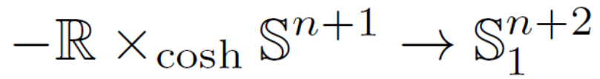
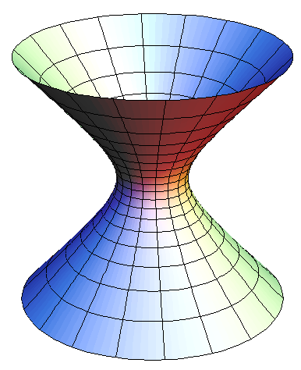
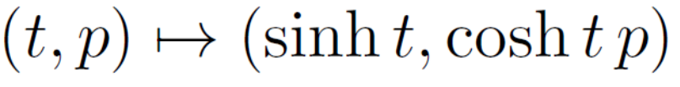
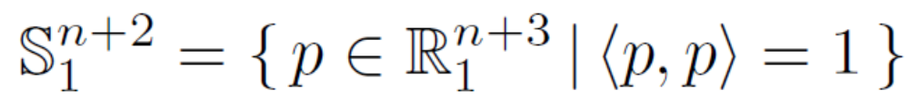
I. Robertson-Walker space-times
De Sitter space-time

Slide 3
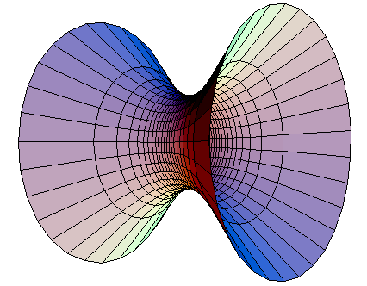

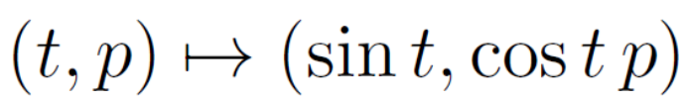
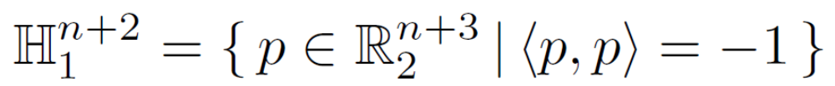
Robertson-Walker space-times
Anti de Sitter space-time

Slide 4
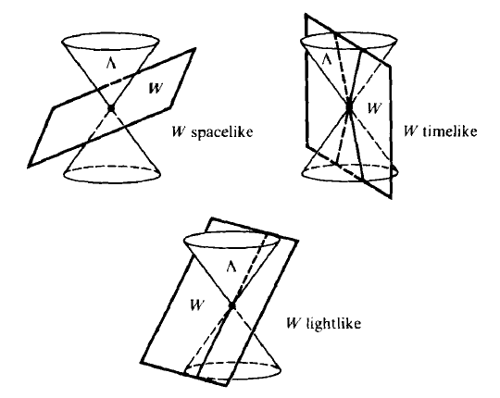
II. Geometry of null submanifolds
From B. O’Neill Semi-Riemannian geometry.

Slide 5
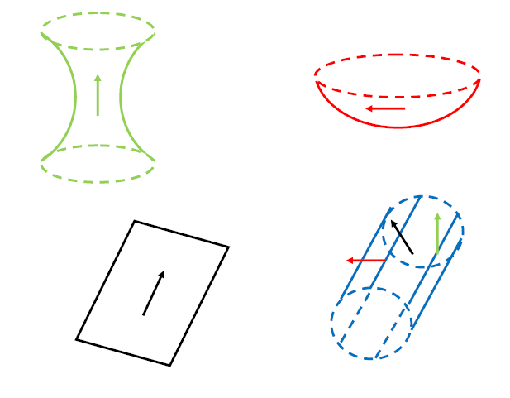
Recall: sub-manifolds might not be metric submanifolds

Slide 6
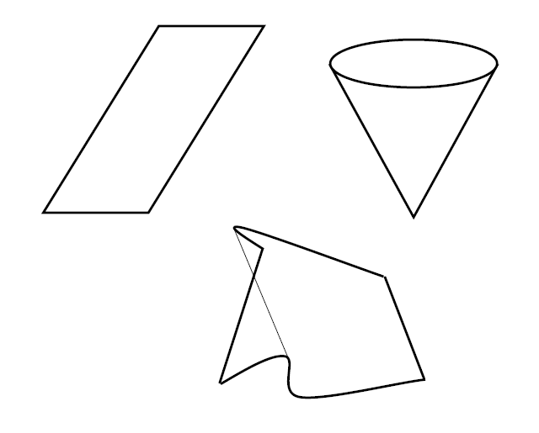
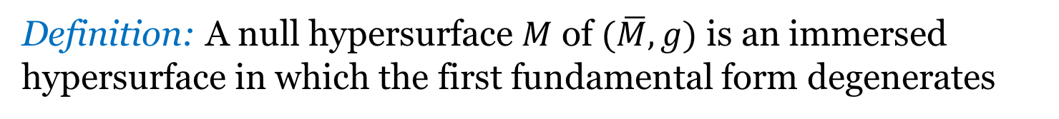
Null hypersurfaces
Definition: A null hypersurface $M$ of $(\overline{M},g)$ is an immersed hypersurface in which the first fundamental form degenerates

Slide 7
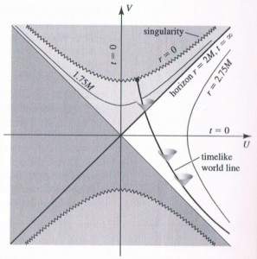
Event horizons
Achronal boundaries
Conformal infinity in AF spacetimes
Etc.
From R. D’Inverno Introducing Einstein’s relativity.

Slide 8
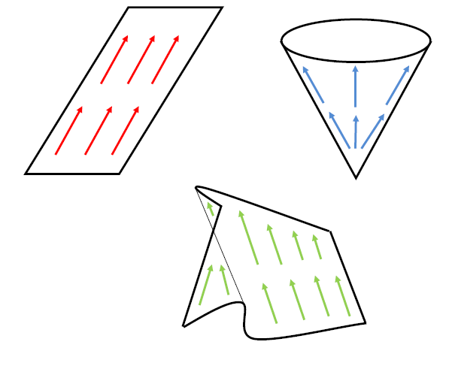
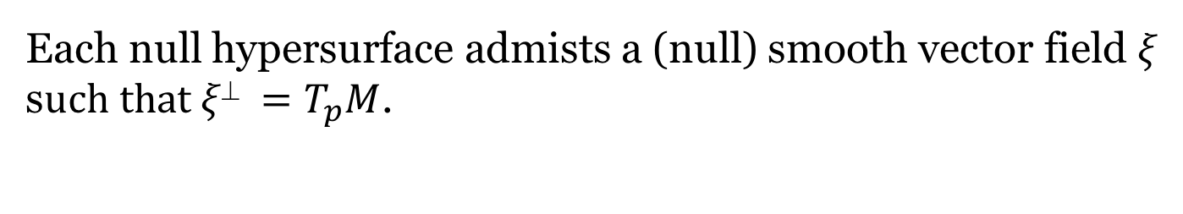
Each null hypersurface admists a (null) smooth vector field $ξ$ s$uch that ξ =T_{p}M$.

Slide 9
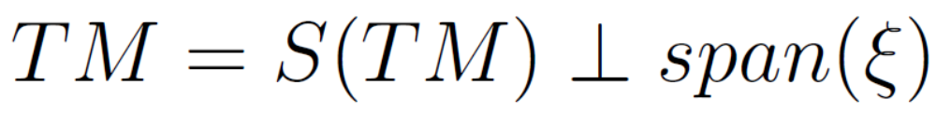
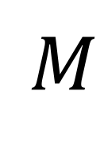
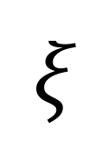
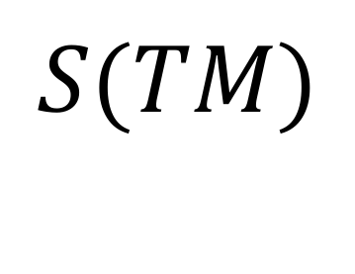
$$S(TM)$$
$$M$$
$$ξ$$

Slide 10

Second Gauss-Weingarten equations

Slide 11
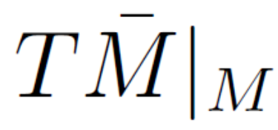
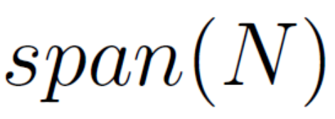
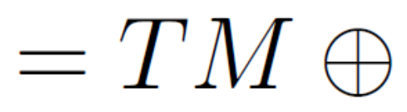
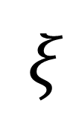
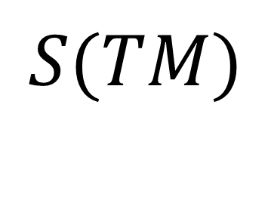
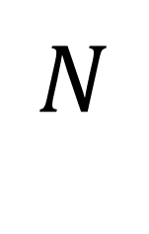
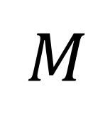
$$S(TM)$$
$$M$$
$$N$$
$$ξ$$

Slide 12
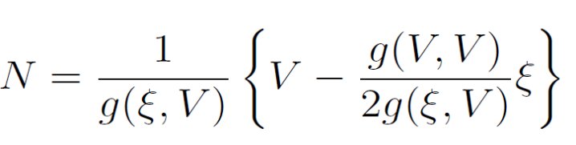
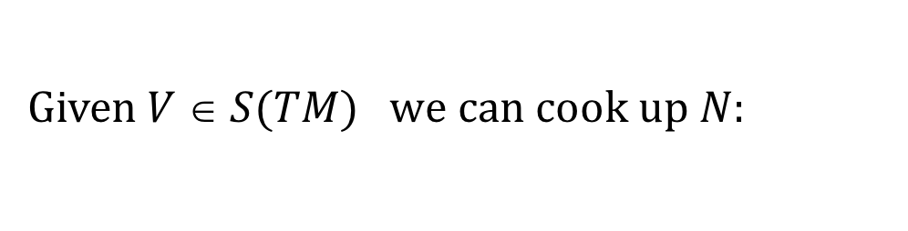
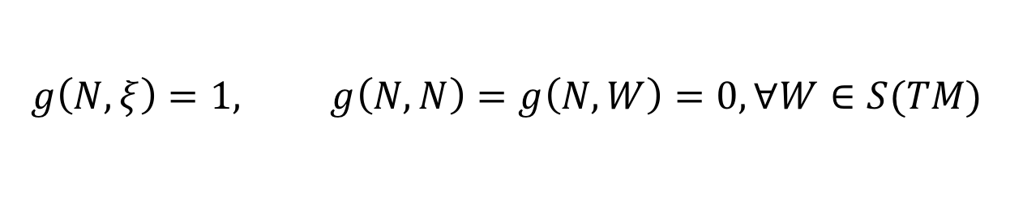
The transverse vector field $N$ is fixed by the conditions:
$$g\left(N,ξ\right)=1, g\left(N,N\right)=g\left(N,W\right)=0, ∀W∈S(TM)$$
Given $V  S(TM)$ w$e can cook up N$:

Slide 13
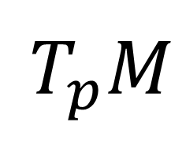
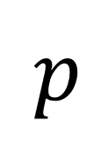
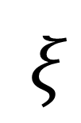
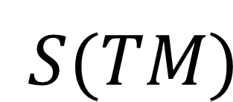
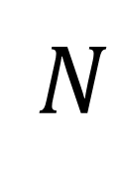
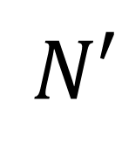
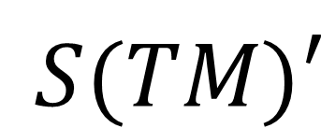
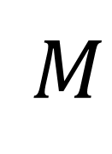
$$N′$$
$$N$$
$$M$$
$$S(TM)′$$
$$p$$
$$T_{p}M$$
$$ξ$$
$$S(TM)$$

Slide 14
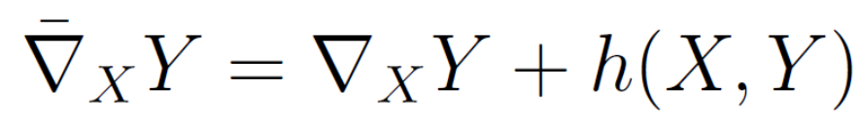
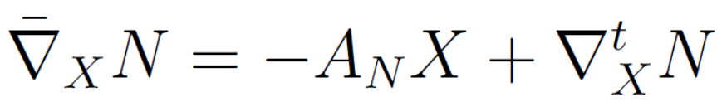
First Gauss-Weingarten equations:
is a torsion-free connection, but it
is not a metric connection.

Slide 15
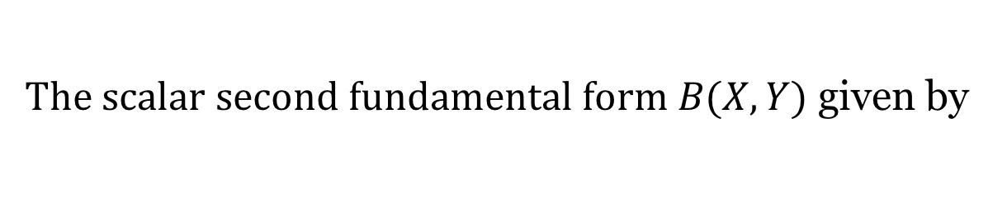

T$he scalar second fundamental form B(X,Y)$ given by
$$h(X,Y)=B(X,Y)N$$
does not depend on the choice of $S(TM)$ and $N$

Slide 16


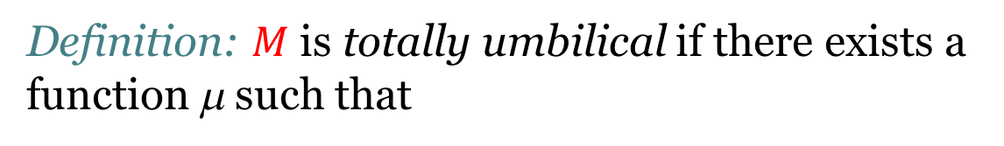
III. Totally umbilic null hypersurfaces
Definition: $M$ is totally umbilical if there exists a function μ such that
$$A_{ξ}^{∗}PX=μPX$$
equivalently
$$B(X,Y)=μg(X,Y)$$

Slide 17
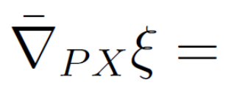

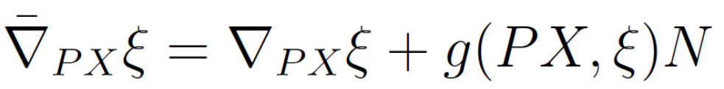
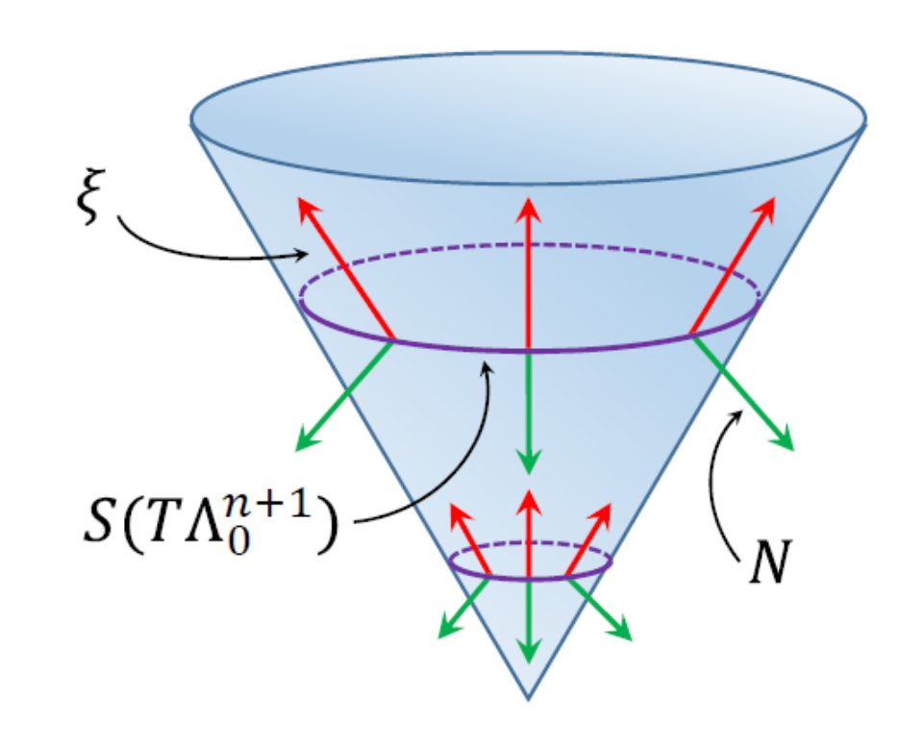
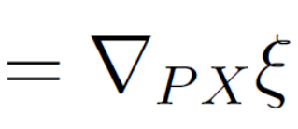



Example: The light cone $Λ_{0}^{n+1}⊂ℝ_{1}^{n+2}$

Slide 18
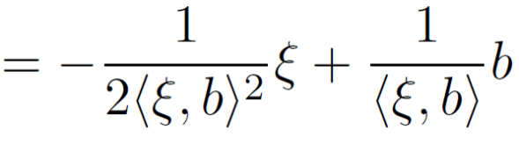

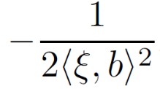


Definition: S(TM) is totally umbilical if there exists a function λ such that
$$A_{N}X=λX$$
Ejemplo: t$he light cone Λ_{0}^{n+1}⊂ℝ_{1}^{n+2}$

Slide 19

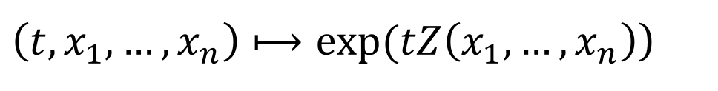
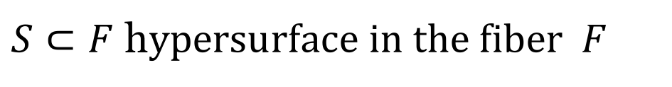
IV. Null hypersurfaces in Robertson-Walker space-times
Fermi coordinates:
$S⊂F$ h$ypersurface in the fiber F$
$p∈S$ $V=U∩S$ $Z:V⟶TV^{⊥}$
$\left(t,x_{1},…,x_{n}\right)⟼exp⁡(tZ\left(x_{1},…,x_{n}\right)$)

Slide 20
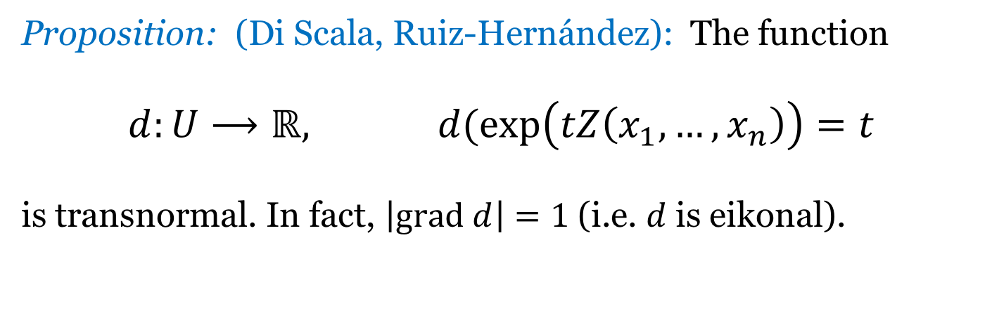
Transnormal functions:
$$\left|grad f\right|=ρ ο f$$
Proposition: (Di Scala, Ruiz-Hernández): The function
$$d:U⟶ℝ, d(\exp\left(tZ\left(x_{1},…,x_{n}\right)\right)=t$$
is transnormal. In fact, $\left|grad d\right|=1$ (i.e. $d$ is eikonal).

Slide 21

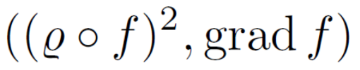

Proposition: (Navarro, Palmas, -): The graph
$\left\{\left(f\left(p\right),p\right) | p∈F\right\}$
of a function $f:F⟶ℝ$ is a null hypersurface if and only if f is transnormal.
Proof: is normal to the graph of f.

Slide 22



Proposition (Navarro, Palmas, -): Let $f:F⟶ℝ$ be a function whose graph is a null hypersurface. Then, for each p there exists a neighborhood U and a hypersurface S of F such that
${\left.f\right|}_{U}=g^{−1} ο d,$ $g\left(s\right)=\int_{a}^{s}{\frac{1}{ρ(σ)}dσ}$
Proof:

Slide 23




Example:

Slide 24




Slide 25








Slide 26




Proposition (Navarro, Palmas, -): Let $M⊂𝕂_{1}^{n+2}$ be a complete, connected, totally umbilical null hypersurface. Then M is the intersection of $𝕂_{1}^{n+2}$ with a hyperplene in the ambient space $ℝ_{s}^{n+3}$
Proof:
is a semi-riemannian submersion
is a totally umbilical hypersurface in F =

Slide 27






Proposición (Navarro, Palmas, -): Let $M⊂𝕂_{1}^{n+2}$ be a totally umbilical null hypersurface a$nd S⊂M$a spacelike hypersurface. Then $S$ is totally umbilical in M if and only if $S$ is contained in a totally geodesic hypersurface of $𝕂_{1}^{n+2}$.
Proof:
Δ = span is parallel along S

Slide 28



V. Quasi-conformal Null Hypersurfaces
Definition: The pair (M, S) is screen quasi-conformal if the s$hape operators A_{N}$ y $A_{ξ}^{∗}$ satisfy
$$A_{N}=φA_{ξ}^{∗}+ψP$$
Proposition (Navarro, Palmas, -): Let $M$ be a null hypersurface in $(\overline{M},g)$. Then M es screen quasi-conformal if and only if
The shape operators $A_{N}$ y $A_{ξ}^{∗}$ commute
Their principal curvatures satisfy
$μ_{0}=λ_{0}=0$ y $μ_{i}=φλ_{i}+ψ$

Slide 29





For Robertson-Walker space-times…

Slide 30

Main idea: Translate geometrical properties of $S$ to $M$.
Proposition (Navarro, Palmas, -) Let $M$ be a screen quasi-conformal null hypersurface i$n (\overline{M},g)$. Then $M$ is totally umbilical if and only if $S$ is totally umbilical a codimension 2 spacelike submanifold of $(\overline{M},g)$.
¡ It works !

Slide 31

VI. Applications
Work in progress: Classification of null hypersurfaces
Screen isoparametric
Einstein
Definition: Let $𝕂_{1}^{n+2}$be a Lorentzian spaceform and $(M, S)$a screen quasi-conformal null hypersurface. W$e say (M, S) i$s screen isoparametric i$f all of its S$-principal curvatures a$re constant along S$.

Slide 32

Proposition (Navarro, Palmas, -): Let $𝕂_{1}^{n+2}=−I×_{ρ}F$ a Robertson-Walker spacetime and $M$a null hypersurface given by the graph of a transnormal function. Then $(M, S) i$s screen isoparametric if and only if e$ach S_{t}$ is isoparametric in $\{t\}×F$.

Slide 33



Cartan Fromulas:
Theorem (Navarro, Palmas, -): Let $𝕂_{1}^{n+2}\left(\overline{c}\right)=−I×_{ρ}F$ be a Robertson-Walker spacetime, $(M, S)$a screen isoparamteric null hypersurface and $λ_{1}, …,λ_{l} the$ $S$- principal curvatures of $M$ (w$ith multiplicites m_{1}, …,m_{l}$). Then
Corollary (Navarro, Palmas, -): Let $𝕂_{1}^{n+2}\left(\overline{c}\right)=−I×_{ρ}F$ be a Robertson-Walker spacetime with $\overline{c}=0,−1$ and $(M, S)$an screen isoparametric null hypersurface. Then there exist at most 2 different $S$-principal curvatures. Moreover, if $\overline{c}=0$ and ther exist 2 distinct principal curvatures, one of them must be equal to $0$.

Slide 34
VI. References
C. Atindogbe et al. Lightlike hypersurfaces in Lorentzian manifolds with constant screen principal curvatures. African Dias. Math. J. (2014)
C. Atindogbe, K. Duggal. Conformal screen of lightlike hypersurfaces. Int. J. Pure Appl. Math. (2004)
T. Cecil, P. Ryan, Geometry of hypersurfaces, Springer-Verlag (2015)
K. Duggal, B. Sahin, Differential geometry of lightlike submanifolds. Birkhäuser (2010)
M. Navarro, O. Palmas, D. Solis, Null screen quasi-conformal hypersurfaces in semi-Riemannian manifolds and applications (2018) (in preparation)
M. Navarro, O. Palmas, D. Solis. Null screen isoparametric hypersurfaces in Lorentzian space forms (2017) (submitted)
M. Navarro, O. Palmas, D. Solis. Null hypersurfaces in generalized Robertson­Walker spacetimes. J. Geom. Phys. 106 (2016)
M. Navarro, O. Palmas, D. Solis, On the geometry of null hypersurfaces in Minkowski space. J. Geom. Phys. 75 (2014),

Slide 35
¡ Thank you !

